Slide 1
Distributed * Systems CPS 512/590 course intro
Jeff Chase
Fall 2015

Slide 2
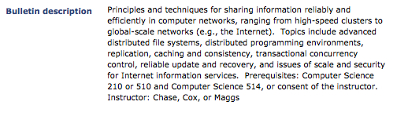
Course synopsis on SISS
CPS 512 for Fall 2015 is a general course in distributed and networked systems. It focuses on techniques for building network services that are reliable and scalable ("cloud"), based primarily on roughly a dozen selected research papers. There will be some programming exercises and a course project. CPS 310 (undergraduate operating systems) is an important prerequisite. Computer networking is helpful, but is not required. The course complements Computer Networking and Distributed Systems (Prof. Theo Benson), which is running concurrently. CPS 512 is cross-listed as a CPS 590 to permit students who have taken CPS 512 with Prof. Maggs to register if they choose: although the topics overlap with Prof. Maggs' CPS 512, the readings and project work will be different. The course is suitable for advanced undergraduates.

Slide 3
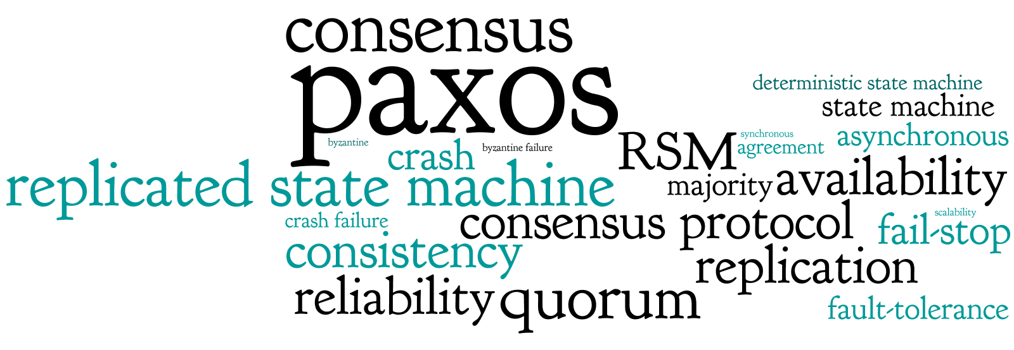
Some topics
From http://paxos.systems

Slide 4
Workload
Reading: 20+ research papers
Reading: a few research papers and some tutorial/survey papers
Exams: midterm two midterms and final
“A couple of labs / exercises” Four labs in scala/akka
Course project
Grading: 50% labs/projects, 50% exams
(Labs/projects in teams of 1-3.)

Slide 5



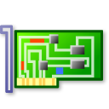

Networked services: big picture
client host
NIC device
Internet “cloud”
client applications
kernel network software
server hosts with server applications
Data is sent on the network as messages called packets.

Slide 6



A simple, familiar example
request
“GET /images/fish.gif HTTP/1.1”
reply
client (initiator)
server
sd = socket(…);
connect(sd, name);
write(sd, request…);
read(sd, reply…);
close(sd);
s = socket(…);
bind(s, name);
sd = accept(s);
read(sd, request…);
write(sd, reply…);
close(sd);

Slide 7
Request/reply messaging
client
server
Remote Procedure Call (RPC) is one common example of this pattern.
request
compute
reply

Slide 8
Remote Procedure Call (RPC)
“RPC is a canonical structuring paradigm for client/server request/response services.”
Used in .NET, Android, RMI, distributed component frameworks
First saw wide use in 1980s client/server systems for workstation networks (e.g., Network File System).
Humans focus on getting this code right.
client
server
Auto-generate this code from API spec (IDL).
“glue”
[sockets]
[sockets]
This code is “canned”, independent of the specific application.

Slide 9

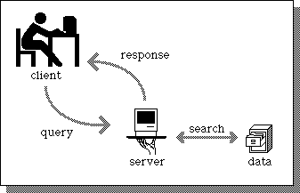
A service
Client
request
Web Server
client
reply
server
App Server
DB Server
Store

Slide 10
Scaling a service
Dispatcher
Work
Support substrate
Server cluster/farm/cloud/grid
Data center
Add servers or “bricks” for scale and robustness.
Issues: state storage, server selection, request routing, etc.

Slide 11
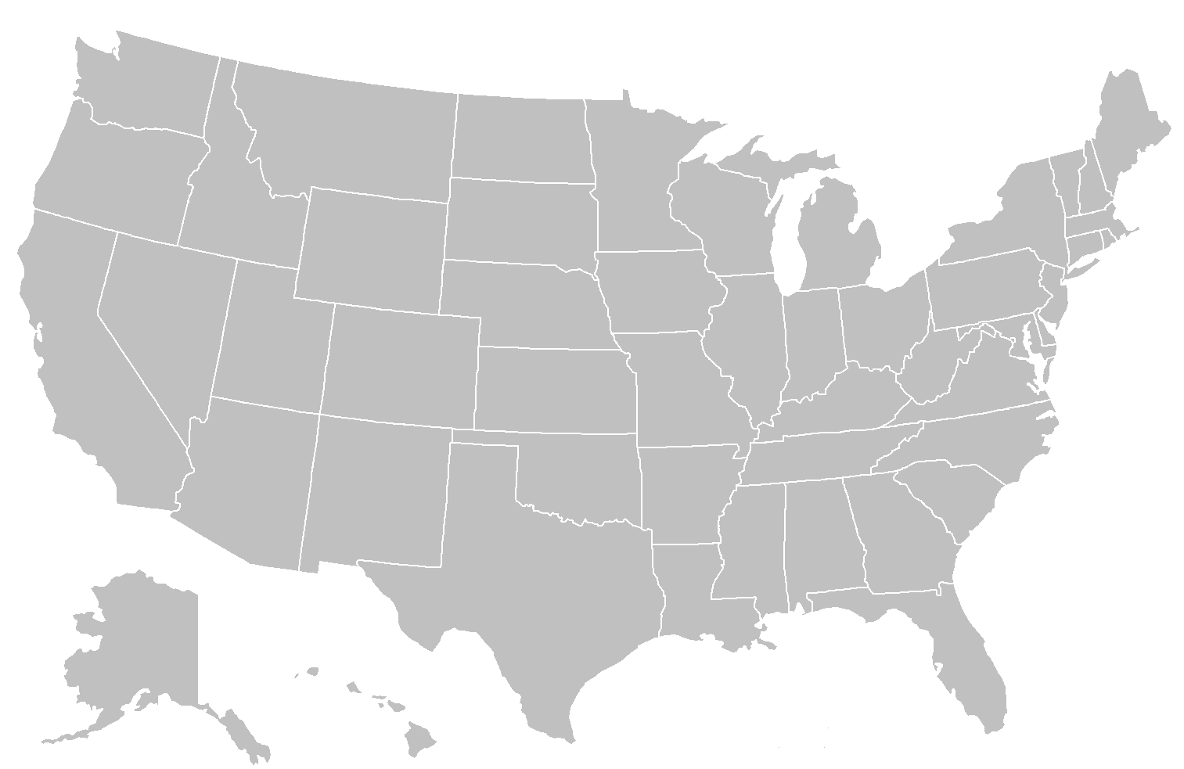
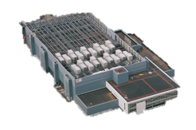
Wide-Area Storage
Serves Requests Quickly
Don’t Settle for Eventual
Wyatt Lloyd [SOSP’11]

Slide 12
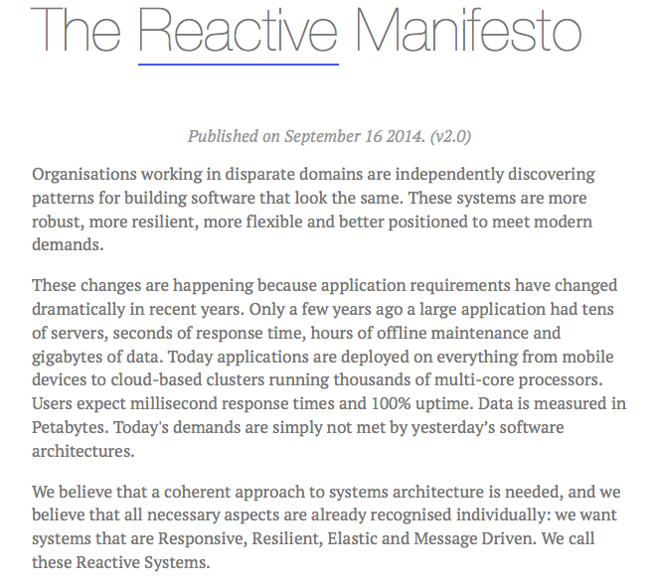
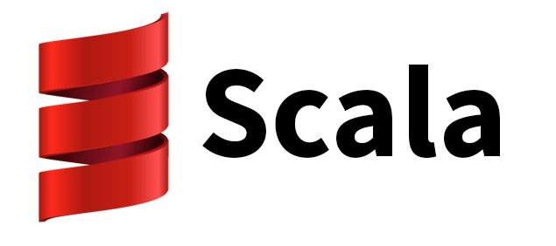

http://www.reactivemanifesto.org/

Slide 13

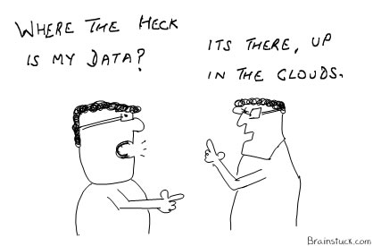
What is a distributed system?
"A distributed system is one in which the failure of a computer you didn't even know existed can render your own computer unusable." -- Leslie Lamport
Leslie Lamport

Slide 14

What about failures?
X
Systems fail. Here’s a reasonable set of assumptions about failure properties for servers/bricks (or disks)
Fail-stop or fail-fast fault model
Nodes either function correctly or remain silent
A failed node may restart, or not
A restarted node loses its memory state, and recovers its secondary (disk) state
If failures are random/independent, the probability of some failure is linear with the number of units.
Higher scale → less reliable!

Slide 16
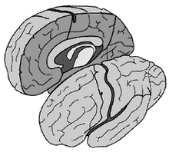

The problem of network partitions
Partitions cause “split brain syndrome”: part of the system can’t know what the other is doing.
A network partition is any event that blocks all message traffic between some subsets of nodes.

Slide 17
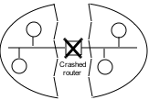
Fischer-Lynch-Patterson (1985)
No consensus can be guaranteed in an asynchronous system in the presence of failures.
Intuition: a “failed” process may just be slow, and can rise from the dead at exactly the wrong time.
Consensus may occur recognizably, rarely or often.
Network partition
Split brain

Slide 18
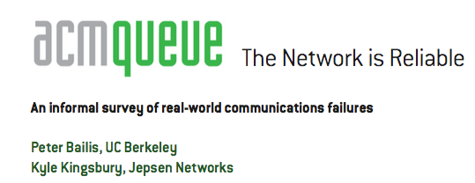
The celebrated FLP impossibility result demonstrates the inability to guarantee consensus in an asynchronous network (i.e., one facing indefinite communication partitions between processes) with one faulty process. This means that, in the presence of unreliable (untimely) message delivery, basic operations such as modifying the set of machines in a cluster (i.e., maintaining group membership, as systems such as Zookeeper are tasked with today) are not guaranteed to complete in the event of both network asynchrony and individual server failures.
…
Therefore, the degree of reliability in deployment environments is critical in robust systems design and directly determines the kinds of operations that systems can reliably perform without waiting. Unfortunately, the degree to which networks are actually reliable in the real world is the subject
of considerable and evolving debate.
…
CONCLUSIONS: WHERE DO WE GO FROM HERE?
This article is meant as a reference point—to illustrate that, according to a wide range of (often informal) accounts, communication failures occur in many real-world environments. Processes, servers, NICs, switches, and local and wide area networks can all fail, with real economic consequences. Network outages can suddenly occur in systems that have been stable for months at a time, during routine upgrades, or as a result of emergency maintenance. The consequences of these outages range from increased latency and temporary unavailability to inconsistency, corruption, and data loss. Split-brain is not an academic concern: it happens to all kinds of systems—sometimes for days on end. Partitions deserve serious consideration.

Slide 19

“CAP theorem”
consistency
C
C-A-P “choose two”
Dr. Eric Brewer
CA: available, and consistent, unless there is a partition.
CP: always consistent, even in a partition, but a reachable replica may deny service if it is unable to agree with the others (e.g., quorum).
A
P
AP: a reachable replica provides service even in a partition, but may be inconsistent.
Availability
Partition-resilience

Slide 20
Cornerstone: data tier
Data volumes are growing enormously.
Mega-services are “grounded” in data.
How to scale the data tier?
Scaling requires dynamic placement of data items across data servers, so we can grow the number of servers.
Sharding divides data across multiple servers or storage units.
Caching helps to reduce load on the data tier.
Replication helps to survive failures and balance read/write load.
Caching and replication require careful update protocols to ensure that servers see a consistent view of the data.

Slide 21
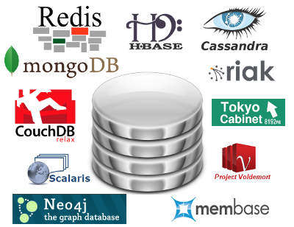

Storage services: 31 flavors
Can we build rich-functioned services on a scalable data tier that is “less” than an ACID database or even a consistent file system?
People talk about the “NoSQL Movement” to scale the data tier beyond classic databases. There’s a long history.
Consistency is creeping back. Today we hear about “NewSQL” and “ACID 2.0”.

Slide 22


Key-value stores
Over the next couple of years, Amazon transformed internally into a service-oriented architecture. They learned a tremendous amount…
- pager escalation gets way harder….build a lot of scaffolding and metrics and reporting.
- every single one of your peer teams suddenly becomes a potential DOS attacker. Nobody can make any real forward progress until very serious quotas and throttling are put in place in every single service.
- monitoring and QA are the same thing. You'd never think so until you try doing a big SOA. But when your service says "oh yes, I'm fine", it may well be the case that the only thing still functioning in the server is the little component that knows how to say "I'm fine, roger roger, over and out" in a cheery droid voice. In order to tell whether the service is actually responding, you have to make individual calls. The problem continues recursively until your monitoring is doing comprehensive semantics checking of your entire range of services and data, at which point it's indistinguishable from automated QA. So they're a continuum.
- if you have hundreds of services, and your code MUST communicate with other groups' code via these services, then you won't be able to find any of them without a service-discovery mechanism. And you can't have that without a service registration mechanism, which itself is another service. So Amazon has a universal service registry where you can find out reflectively (programmatically) about every service, what its APIs are, and also whether it is currently up, and where.
- debugging problems with someone else's code gets a LOT harder, and is basically impossible unless there is a universal standard way to run every service in a debuggable sandbox.
That's just a very small sample. There are dozens, maybe hundreds of individual learnings like these that Amazon had to discover organically. There were a lot of wacky ones around externalizing services, but not as many as you might think. Organizing into services taught teams not to trust each other in most of the same ways they're not supposed to trust external developers.
This effort was still underway when I left to join Google in mid-2005, but it was pretty far advanced. From the time Bezos issued his edict through the time I left, Amazon had transformed culturally into a company that thinks about everything in a services-first fashion. It is now fundamental to how they approach all designs, including internal designs for stuff that might never see the light of day externally.
Many mega-services are built on key-value stores.
Store variable-length content objects: think “tiny files” (value)
Each object is named by a “key”, usually fixed-size.
Key is also called a token: not to be confused with a crypto key! Although it may be a content hash (SHAx or MD5).
Simple put/get interface with no offsets or transactions (yet).
Goes back to literature on Distributed Data Structures [Gribble 2000] and Distributed Hash Tables (DHTs).
[image from Sean Rhea, opendht.org, 2004]

Slide 23
Key-value stores
Data objects named in a “flat” key space (e.g., “serial numbers”)
K-V is a simple and clean abstraction that admits a scalable, reliable implementation: a major focus of R&D.
Is put/get sufficient to implement non-trivial apps?
Distributed application
put(key, data)
get (key)
data
Distributed hash table
lookup(key)
node IP address
Lookup service
node
node
….
node
[image from Morris, Stoica, Shenker, etc.]

Slide 24

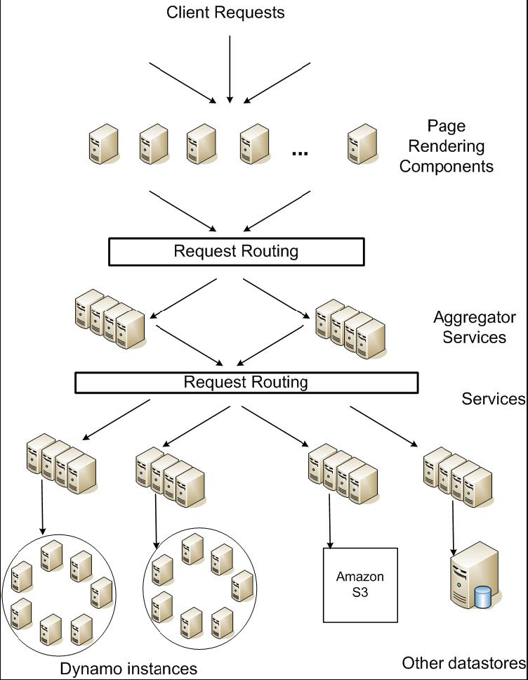
Service-oriented architecture of
Amazon’s platform
Dynamo is a scalable, replicated key-value store.

Slide 25

Inside the Datacenter
Web Tier
Storage Tier
A-F
Replication
Remote DC
G-L
Web Tier
Storage Tier
A-F
M-R
G-L
M-R
S-Z
S-Z
Don’t Settle for Eventual
Wyatt Lloyd [SOSP’11]

Slide 26
Scalability
Increase capacity and throughput in each datacenter
A-C
A-Z
A-Z
A-F
A-F
A-L
A-C
A-L
D-F
G-L
G-L
M-Z
D-F
M-Z
G-J
M-R
M-R
G-J
K-L
S-Z
S-Z
K-L
M-O
M-O
P-S
P-S
T-V
T-V
W-Z
W-Z
Don’t Settle for Eventual
Wyatt Lloyd [SOSP’11]

Slide 27
Labs / exercises
• Sep 17 (Th) Scala/Akka warmup: publish-subscribe service using a key-value store
• Oct 1 (Th) Lab #2: lease/lock service
• Oct 5 (W) Project proposal (a few paragraphs)
^{• Oct 6 (T) Midterm exam}
• Oct 20 (T) Lab #3: atomic transactions
^{• Nov 3 (T) Midterm exam}
^{• Nov 10 (T) Lab #4: consensus}
• Dec XX Project demo/presentation, reports due
• Dec 8 (T) Final exam (7:00 PM - 10:00 PM)

Slide 28
A key-value store in Akka/Scala (?)
sealed trait RingStoreAPI case class Put(key: BigInt, cell: RingCell) case class Get(key: BigInt) class RingStore extends Actor { private val store = new scala.collection.mutable.HashMap[BigInt, RingCell] override def receive = { case Put(key, cell) => sender ! store.put(key,cell) case Get(key) => sender ! store.get(key) } }

Slide 29
Instantiating an Akka actor
object RingStore { def props(): Props = { Props(classOf[RingStore]) } }
// Storage tier: create K/V store servers val stores = for (i <- 0 until numNodes) yield system.actorOf(RingStore.props(), "RingStore" + i)

Slide 30
Looking up a value named by a string
private def hashForKey(anything: String): BigInt = { val md: MessageDigest = MessageDigest.getInstance("MD5") val digest: Array[Byte] = md.digest(string.getBytes) BigInt(1, digest) }

Slide 31
An “RPC call”
implicit val timeout = Timeout(5 seconds)
import scala.concurrent.ExecutionContext.Implicits.global
def read(key: BigInt): Option[RingCell] = {
val future = ask(route(key), Get(key)).mapTo[Option[RingCell]]
val optValue = Await.result(future, timeout.duration)
}
if (optValue.isDefined)
optValue.get
else…

Slide 32
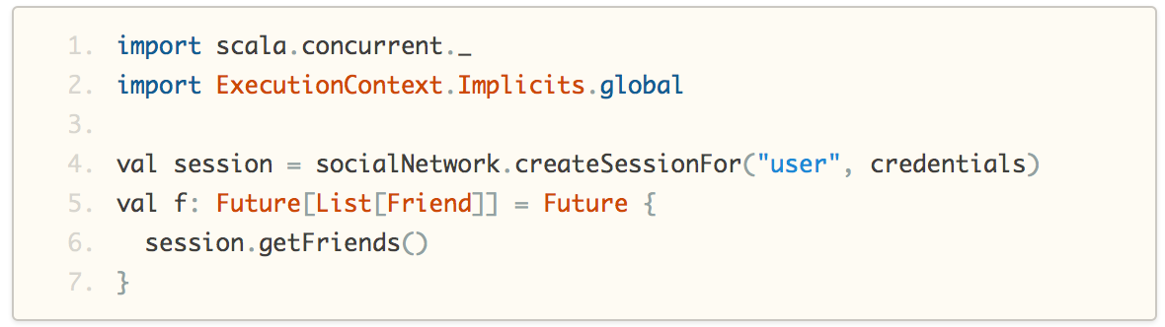
Concurrency in Scala
http://docs.scala-lang.org/overviews/core/futures.html

Slide 33
Secure networked systems
In November we will study some topics in secure networked systems.
Brief review of basic crypto (PKI, SSL, signing, certificates)
Security for multi-domain (“federated”) Internet-scale systems
Examples: DNS(SEC), federated clouds, P2P-DHT, Bitcoin
Distributed authorization and accountability
Using trust logic as a system-building tool

Slide 34
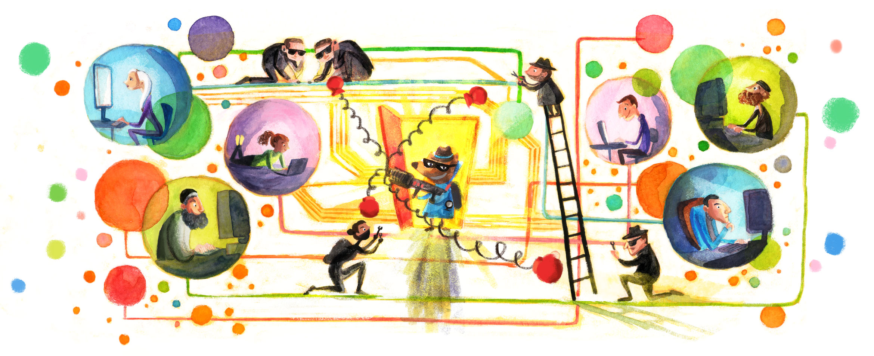

Principals in a networked system
[https://keybase.io]

Slide 35



Principals in a networked system
Principals are users or organizations, or software entities acting on their behalf.
Mallory
Bob
attack
How can principals communicate securely? How do they decide whom to trust?
Alice

Slide 36





AuthZ 101
service
subject
action
object
reference
monitor
applies
guard policy
subj/obj attributes
policy rules
Authenticated by
PKI / SSL / MAC
“subject says action”
checker
credentials
guard
Alice
request
object
identity
requester
(subject)
authorizer

Slide 37
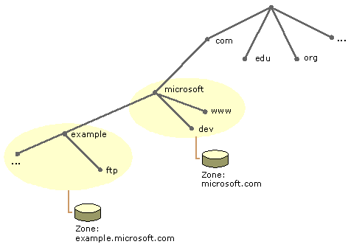

DNS as a distributed service
DNS is a “cloud” of name servers
owned by different entities (domains)
organized in a hierarchy (tree) such that
each controls a subtree of the name space.

Slide 38
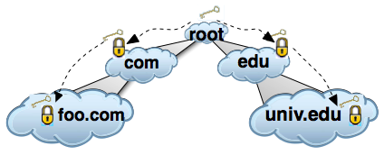
DNSSEC
How to make DNS more secure?
Answer: sign all DNS lookup responses and include target’s public key.
Each parent domain endorses the public key of each child.
Resolver can validate the response chain, all the way back to the root…

Slide 39

Trust with SAFE logic
SAFE: Secure Authorization for Federated Environments
Practical minimalist trust logic: low barrier to use
Custom datalog+says inference engine, <1000 lines of Scala
“Slang” script to publish/import logic statements as certificates
Compose policies and statements easily in plain text
SAFE certificates can carry arbitrary logic content.
A building block for secure networked systems
Certificate
Term of validity
Issuer’s public key
alice: p(X) ← alice: trusts(G), G: p(X)
Payload: statements
“If Alice trusts G and G says p(X) then Alice believes it.”
Signature

Slide 40
DNSSEC (simplified) in trust logic
dns(Parent, Name, Child) :-
Parent: dnsRecord(Parent, Name, Child).
dns(Parent, Name, Child) :-
Parent: dnsRecord(Parent, head(Name), D),
dns(D, tail(Name), Child).

